Slide 1

Analyzing the Million Song Dataset
CIS 602: Project Presentation Instructor: Dr. David Koop
Kevin D’Cruz ID: 01656193 kdcruz@umassd.edu

Slide 2
Overview
Goal
Dataset Information
Sample Dataset
Complete Dataset
Technologies Used
Analysis (Sample and Complete Dataset)
Scalability Challenges
Conclusion
References

Slide 3
Goal
Analyze the Million Song Dataset
Answer a few questions from the dataset
Main Goal: Focusing on the Scalability Factor

Slide 4
Dataset Information
Million Song Dataset: The Echo Nest & LabROSA(Columbia University)
Audio derived features & metadata for a million contemporary popular music tracks
54 Attributes
Sample Dataset
Subset of 10,000 Records (1.8 GB)
Complete Dataset
1 Million Records (280 GB)
Dataset available in HDF5 Format

Slide 5
Dataset Attributes
Field name | Type | Description
analysis sample rate | float | sample rate of the audio used
artist 7digitalid | int | ID from 7digital.com or -1
artist familiarity | float | algorithmic estimation
artist name | string | artist name
artist id | string | Echo Nest ID
artist latitude | float | latitude
artist location | string | location name
artist longitude | float | longitude
artist mbid | string | ID from musicbrainz.org
artist mbtags | array string | tags from musicbrainz.org

Slide 6
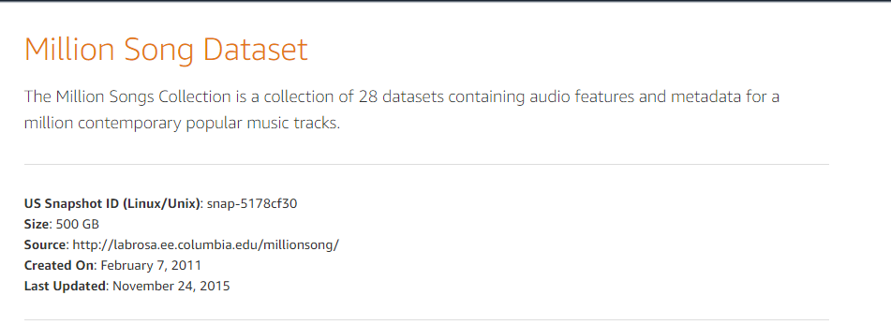
AWS Public Datasets
Source: AWS Public Datasets

Slide 7
Technologies Used
Jupyter Notebook
Python
Pandas/Numpy/Pytables
Pypark
AWS

Slide 8
Initial Data Analysis
Worked on the Sample Subset of Data
1.8 GB; 10,000 Records
Converted from HDF5 to CSV format
Extracted columns from the subset data which were necessary

Slide 9
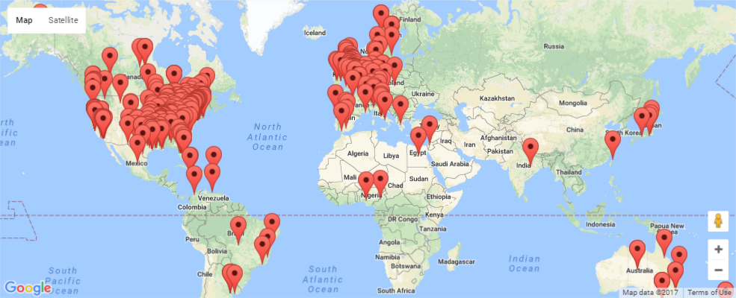
Initial Data Analysis (Subset)
Started working with Pandas and answered the following questions:
Question1: Which location most of the artists came from?

Slide 10
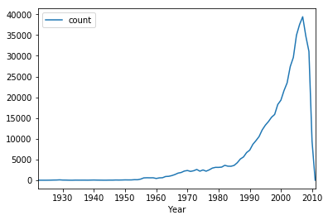
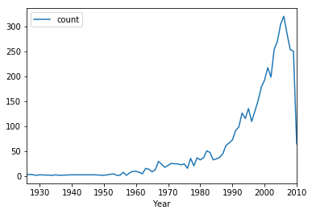
Initial Data Analysis (Subset+Complete)
Question 2: What years had the highest number of album/song releases?
Subset
Complete

Slide 11
Years having topmost counts(As per Song Releases)
Sr no. | Year | Count
0 | 2006 | 320
1 | 2005 | 304
2 | 2007 | 285
3 | 2004 | 270
4 | 2003 | 254
5 | 2008 | 253
Sr no. | Year | Count
0 | 2007 | 39414
1 | 2006 | 37546
2 | 2005 | 34960
3 | 2008 | 34770
4 | 2009 | 31051
5 | 2004 | 29618
Subset
Complete

Slide 12
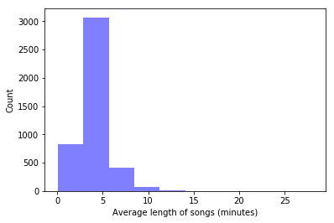
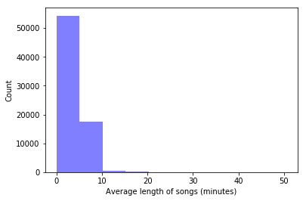
Initial Data Analysis (Subset)
Question 3: What artists had the highest mean Duration of songs (in minutes)?
Subset
Complete

Slide 13
Challenges Faced
Conversion from HDF5 to CSV
Tree Structure format
Configuring Jupyter Notebook and other dependencies on AWS

Slide 14
Scalability Challenges
Large Data for Crunching
Showed 280GB on website, but was 500GB on AWS website
Loading the full data on the local computer because of the size
Used Amazon EMR for accessing the complete data
Single core → Time Consuming
Divided files into 8 Cores (p1-p8) for faster conversion to CSV format
Instance Type used: c4.2xlarge
Pyspark for working on the complete Distributed Data, once converted

Slide 15
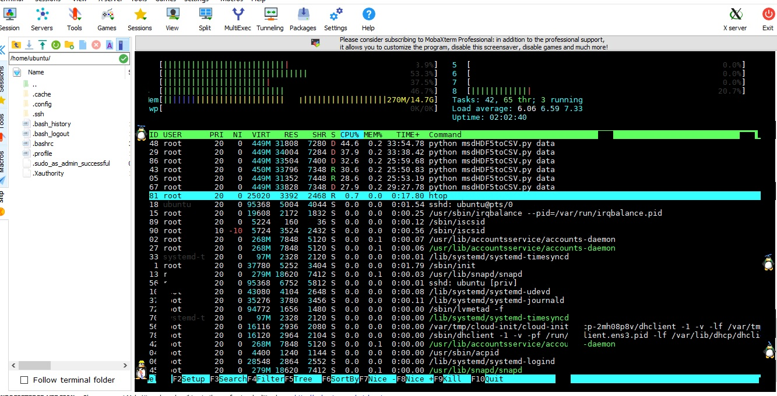
Scalability Challenge

Slide 16
Conclusion
Converted the sample subset data(CSV) on a local PC
Performed Analysis using Pandas and Pyspark (Subset Data)
Pandas was little slow when compared to Pyspark
Converted Full Dataset(CSV) on Amazon EMR
Performed Analysis using Pyspark on the full dataset of 1 million records
All done while keeping a Scalability Factor in mind!

Slide 17
References
[1] THE MILLION SONG DATASET http://ismir2011.ismir.net/papers/OS6-1.pdf
[2] Pyspark, Pandas Documentation http://spark.apache.org/docs/2.2.0/api/python/pyspark.sql.html#pyspark.sql.DataFrame.columns
[3]: Conversion (HDF5 to CSV) reference https://github.com/amgreenstreet/Million-Song-Dataset-HDF5-to-CSV
[4]: AWS Documentation

